Slide 1
IS Application Project NZ Wetlands
Final Presentation

Slide 2
Introduction
Sharish Bala
Background - NZ Wetlands
Demonstration – Update Site, Assign Land Use, Update Land Use, and Land Uses Report
Learnings – C# and SQLite, alternative coding languages
Questions

Slide 3
Background
The project is to design a program for NZ Wetland to manage and adjust a database of information relating to the management of wetlands and their environment and ecosystems.
The methods used to manage and adjust the database involve adding, updating, deleting, assigning and removing information in the database and also producing reports to display the information in the database.

Slide 4
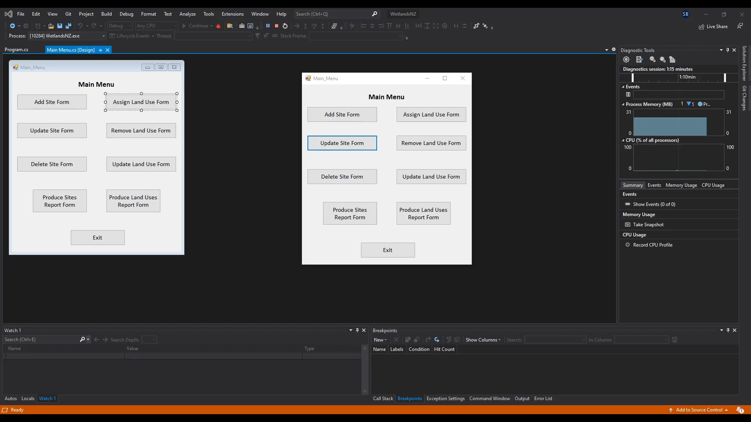
Demonstration

Slide 5
Learnings
From this project I have a better understanding of C# and its functionality with SQLite
The use of SQLite and C# went well allowing for development of the program
If I were to do it again I would possibly use a different, less resource intensive coding language like JavaScript or python

Slide 6
Questions

